Slide 1


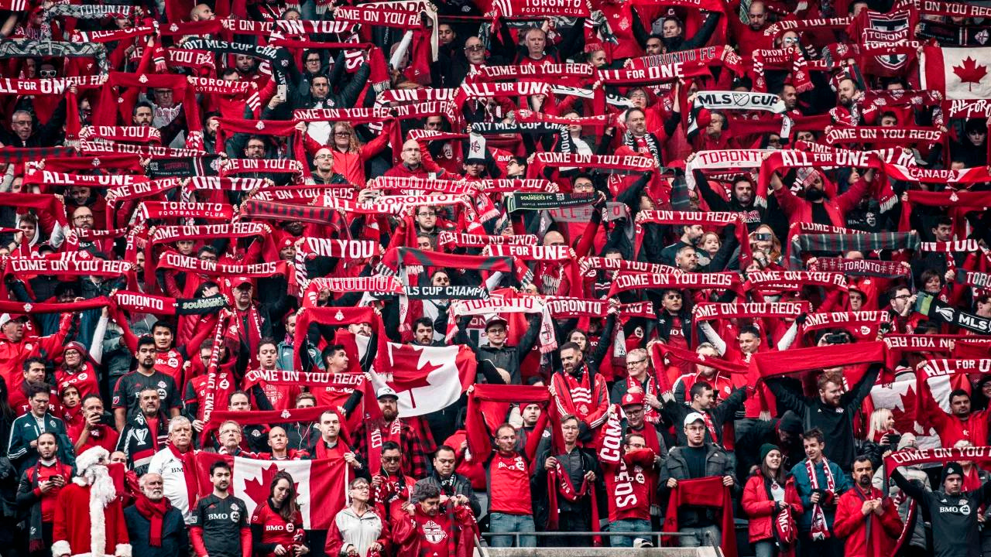




REWARDING
TORONTO FC’S
MOST LOYAL FANS
WEATHER-DRIVEN ATTENDANCE INSIGHTS
ENGAGING THE UNSTOPPABLE
WEEK 4

Slide 2


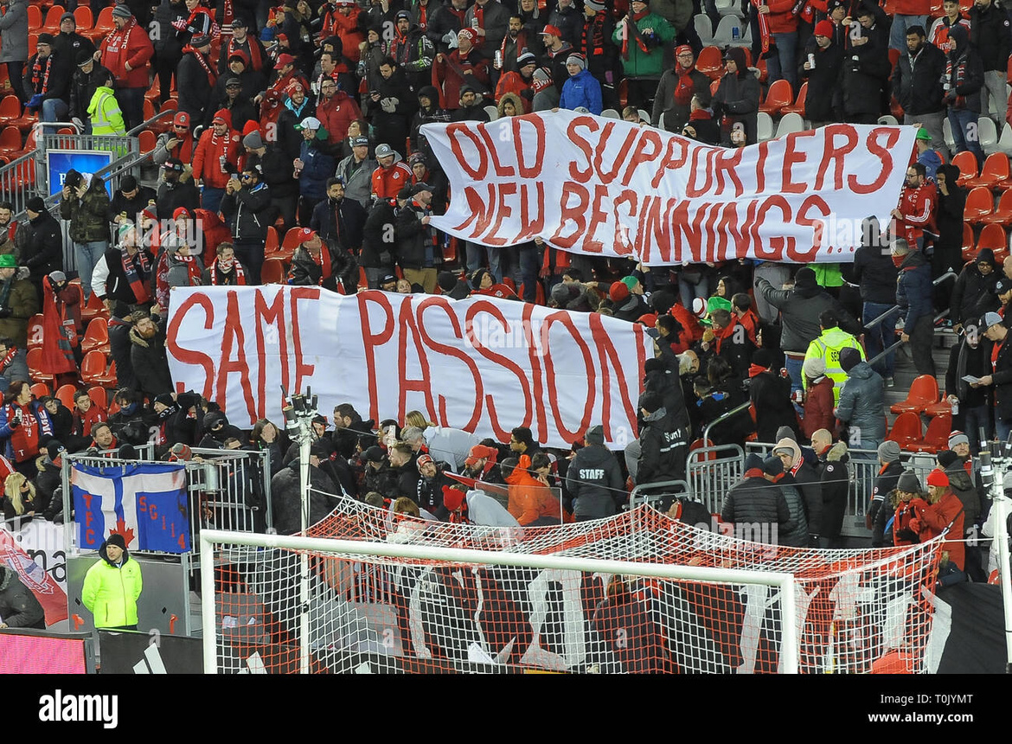
Assess the practicality of creating an algorithm that correlates historical weather data with attendance data.
Provide a well-justified rationale for the final decision on the feasibility of developing the algorithm.
If feasible, outline the potential advantages of implementing the algorithm within the marketing campaign context.
INTRODUCTION
This week we are to delivery the following:

Slide 3




VENKATA MANISH
KATRAGADDA
CHIBUIKE OKOROAMA
PRESCILA MORA
MOHAMED AFTHAB
TEAM MEMBERS

Slide 4

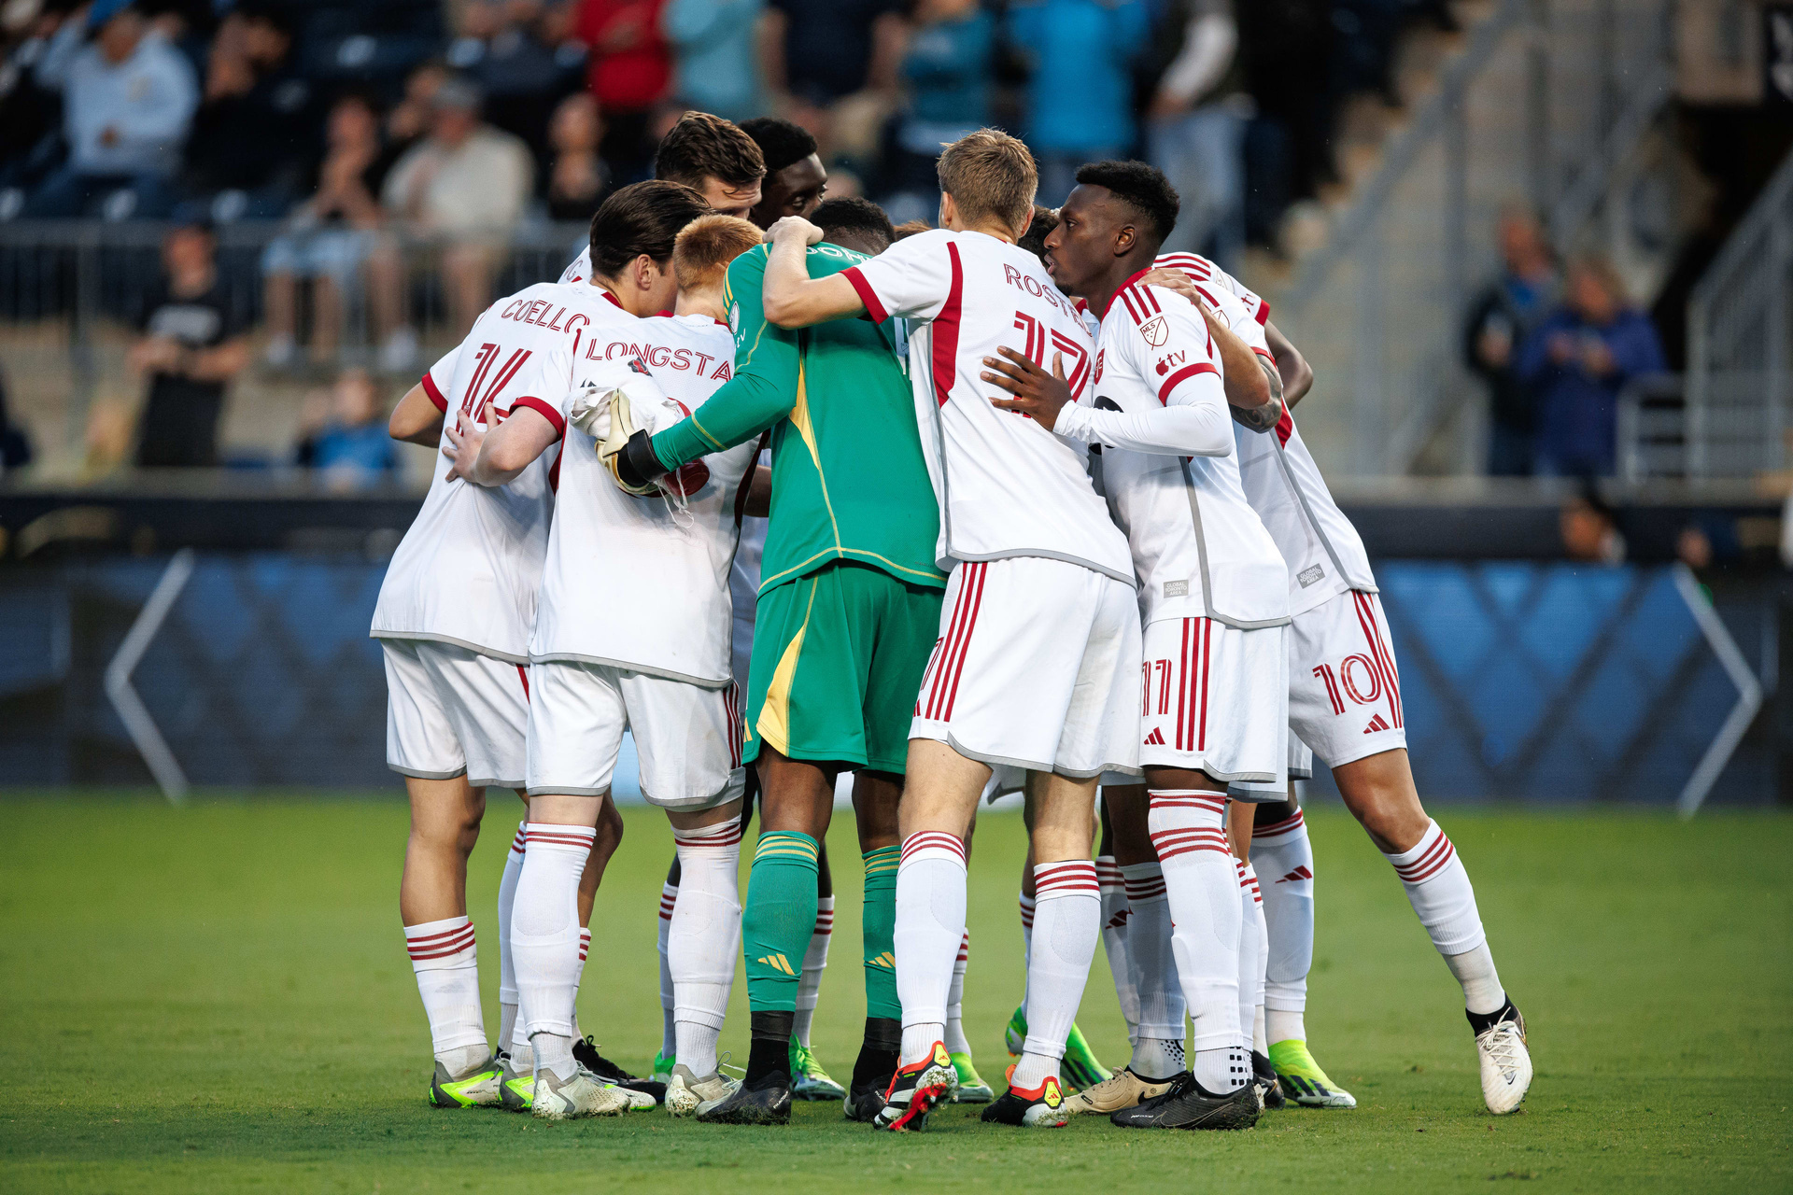
KEY FACTS
Since 2007
Major League Soccer (MLS)
BMO Home Field, 30,991 seating capacity expanded to 40,000
Average Fan Attendance: 25,310 in 2023
ACHIVEMENTS
2017 MLS Cup Champions
Multiple-time Canadian Championship winners

Slide 5
OBJECTIVE
FEASIBILITY ANALYSIS
ON TORONTO FC’s
WEATHER-DRIVEN
FAN LOYALTY ALGORITHM
To assess the feasibility and potential benefits of developing an algorithm that correlates historical weather data with attendance records, aimed at identifying and rewarding Toronto FC's most loyal fans who attend matches despite challenging weather conditions.

Slide 6
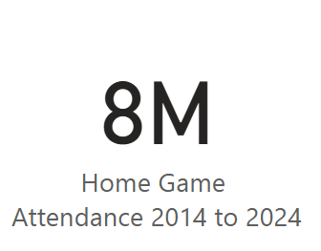
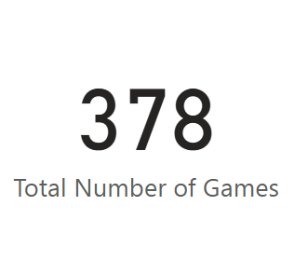
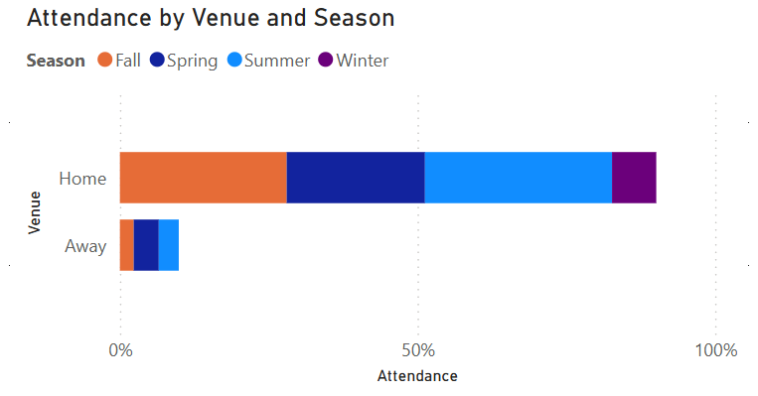
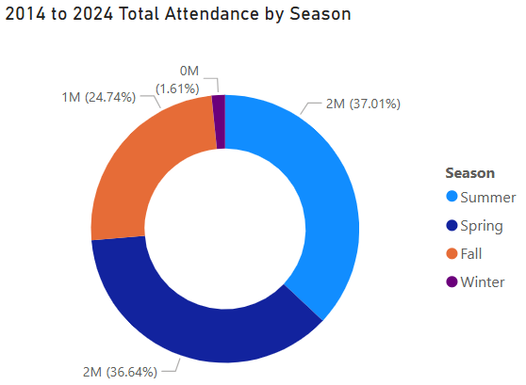
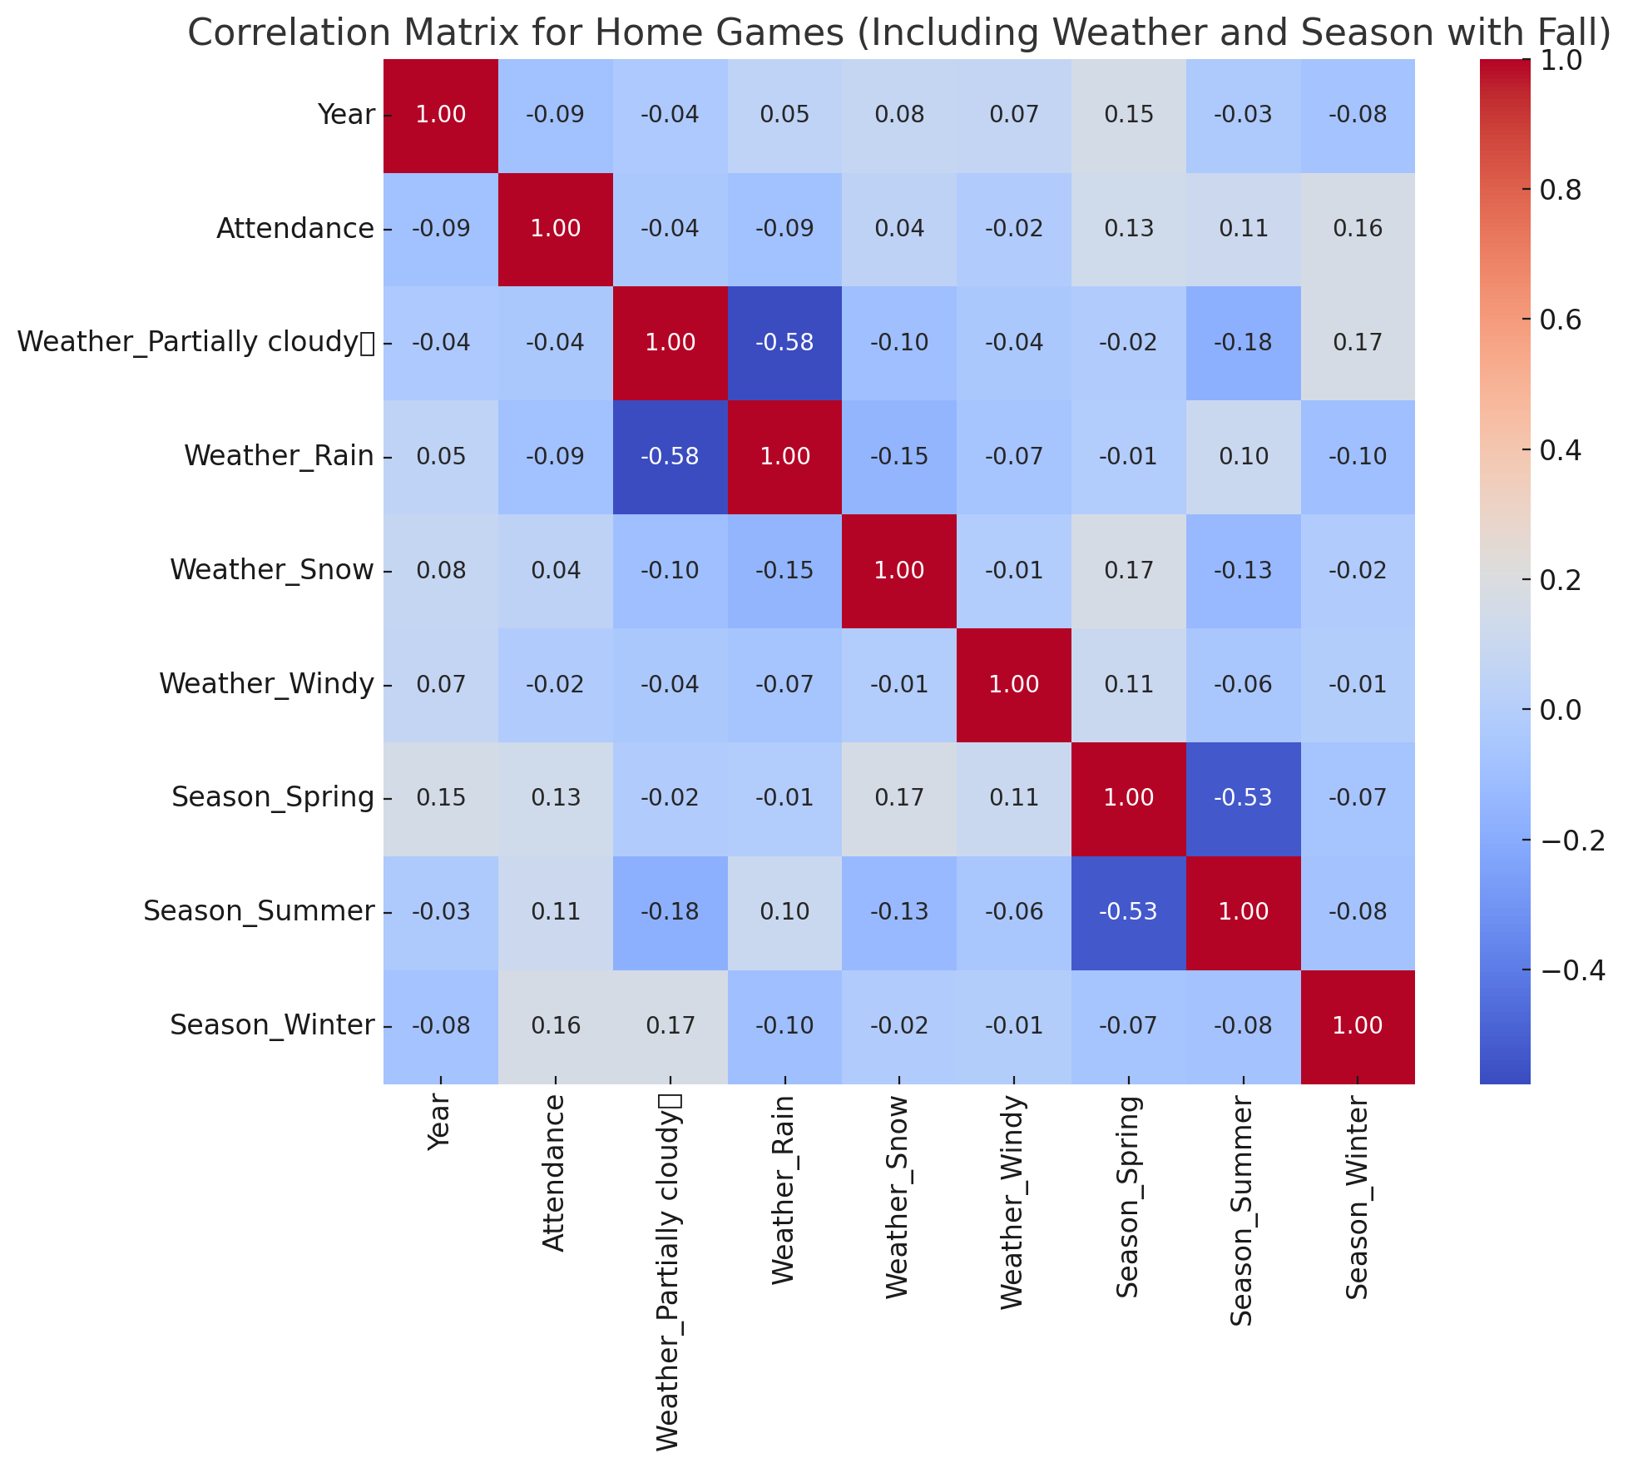
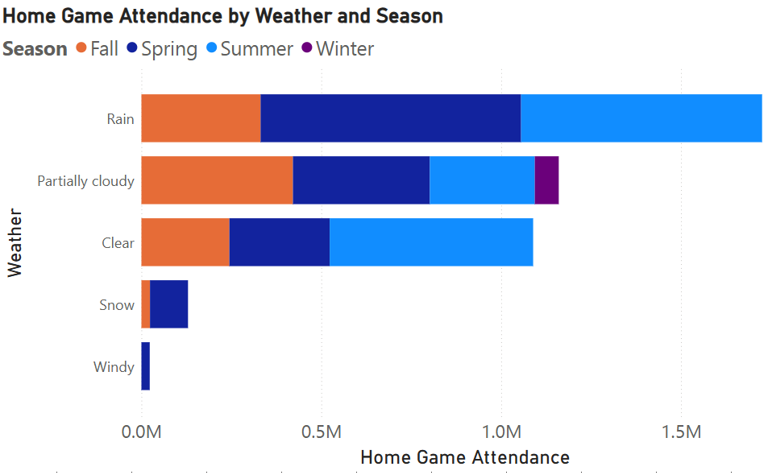
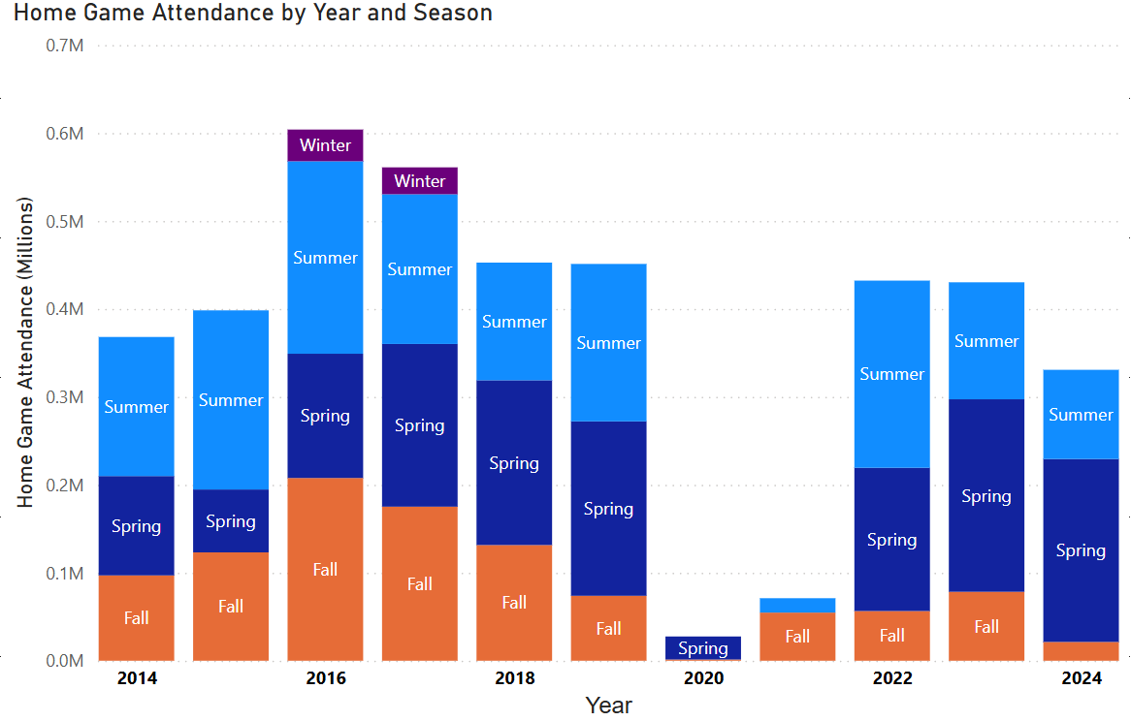
2014 to 2024 Toronto FC Home Games

Slide 7
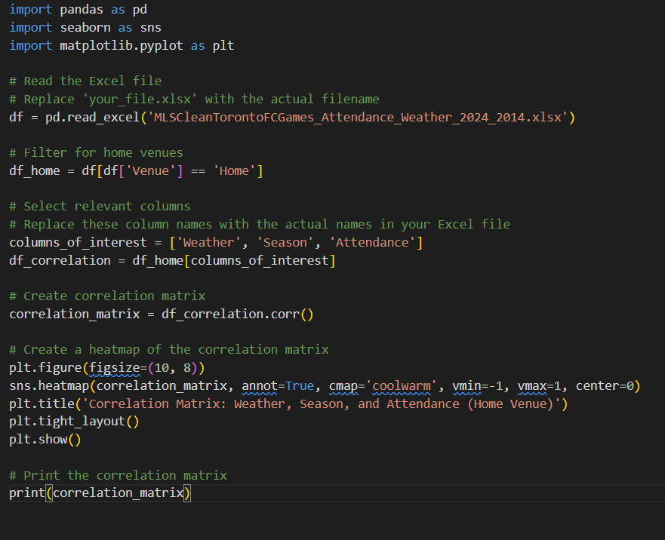
Python code for the correlational matrix

Slide 8
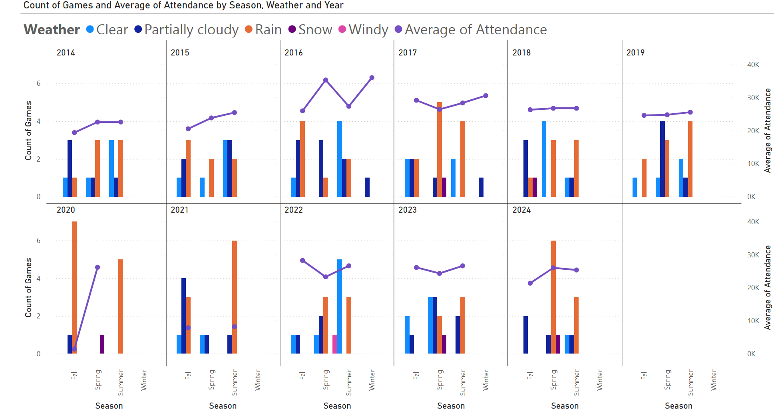
2014 to 2024 Toronto FC’s Home Games
Notes:
After gathering and processing the data that we’ve collected. We created this chart to help us analyze the data. Please take note that these are all MLS games only and Although the team started playing in the MLS since 2007 These charts represent a comprehensive overview of Toronto Football Clubs home games only which is in the BMO field in Toronto from 2014 to 2024, As you can see the left side of the graph marks the numbers of games, and on the right side has the average fan attendance in thousands. The bar represents the number of games in different seasons and weather conditions.
The Seasonal Patterns wherein
- Games are primarily held in Spring, Summer, and Fall.
- Winter games occurred only in 2016 and 2017.
- The Average Fan attendance Trends which is represented by the purple line varies significantly across different seasons and years.
- Clear weather and partially cloudy generally shows higher attendance, especially in summer months.
- Snow and windy conditions are relatively rare and have lower attendance when they do occur and that is the reason on the sudden drop of the average attendance in 2017 since there is a one snowy game that represented by the violet bar, in 2022 there is one windy game the pink bar and then again in 2023 as you can see there is again a violet bar that signify a snowy weather.
- Orange bar represent Rain doesn't seem to have a lower attendance and number of games as much as one might have expected.
This only means that rain or shine Fans are totally committed to support the Toronto football club team.
- Some years (like 2016 and 2017) show particularly high attendance peaks this is the year where Toronto Football Club won the MLS cup, Fan support is very evident that year.
The number of games and their distribution across seasons changes from year to year.
- There's a noticeable drop in games and attendance in 2020 to 2021, due to the COVID-19 pandemic restrictions.
- After the pandemic, there seems to be a gradual recovery in terms the number of game numbers and fans attendance.
- There's an overall there is an increase in the number of games here in Canada from 2014 to 2024, with some fluctuations.

Slide 9

assessing the algorithm feasibility
METHODOLOGY
Data Collection and Analysis
KEY FACTORS SUPPORTING PRACTICALITY
Gather historical weather data, fan attendance
Analyze data for pattern and correlation
Abundant data sources available
Existing technology sufficient for implementation
Clear correlations potential between weather and attendance
Algorithm Design
Define key variable
Identify model
Implementation Planning
Asses technical requirements
Determine integration points with existing systems
Plan for data privacy and security measures

Slide 10
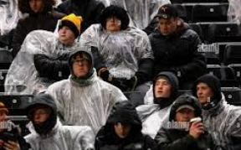



feasibility rationale
DATA AVAILABILITY
TECHNICAL CAPABILITY
DEFINED OBJECTIVE
RESOURCE CONSIDERATION
Weather records accessible from reliable sources
Comprehensive attendance data maintained by Toronto FC
Modern analytics tools can handle required complexity
Existing infrastructure can support implementation
Clear goal enables focused development
Measurable outcomes for evaluation
Achievable with proper planning and allocation
Potential ROI justifies resource investment

Slide 11


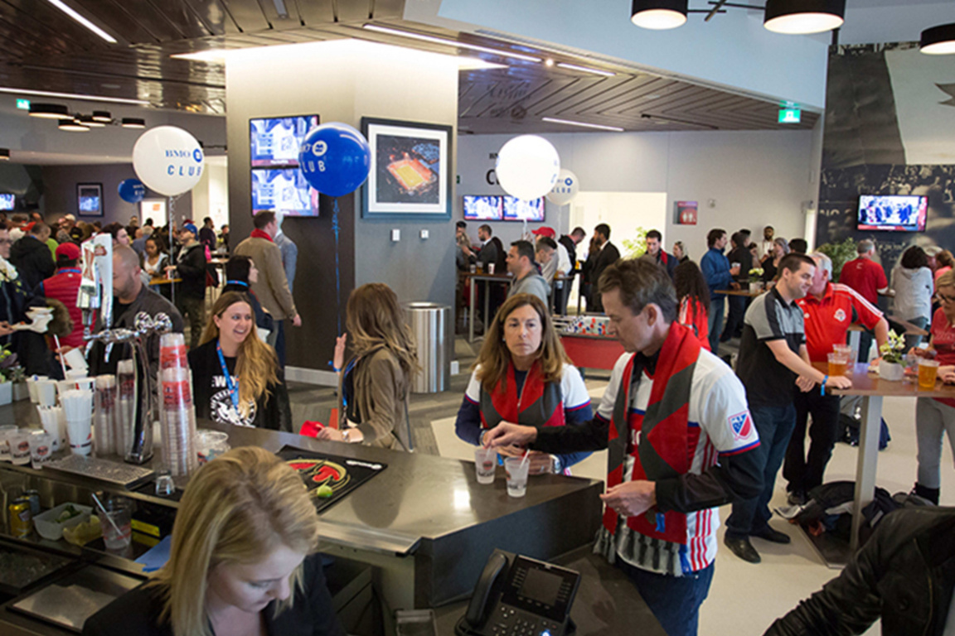

POTENTIAL ADVANTAGES
ENHANCED FAN ENGAGEMENT
DATA-DRIVEN MARKETING
INCREASED ATTENDANCE
COMPETITIVE
EDGE
Recognize and
reward loyalty
CREATE A
STRONGER EMOTIONAL
CONNECTION WITH
DEDICATED FANS
Tailor promotions based on weather forecasts
OPTIMIZE TICKET PRICING STRATEGIES
Incentivize attendance during typically low-turnout games
POTENTIALLY BOOST OVERALL SEASON ATTENDANCE
Unique approach in sports marketing
DEMONSTRATE INNOVATIVE USE OF DATA ANALYTICS IN FAN RELATIONS

Slide 12

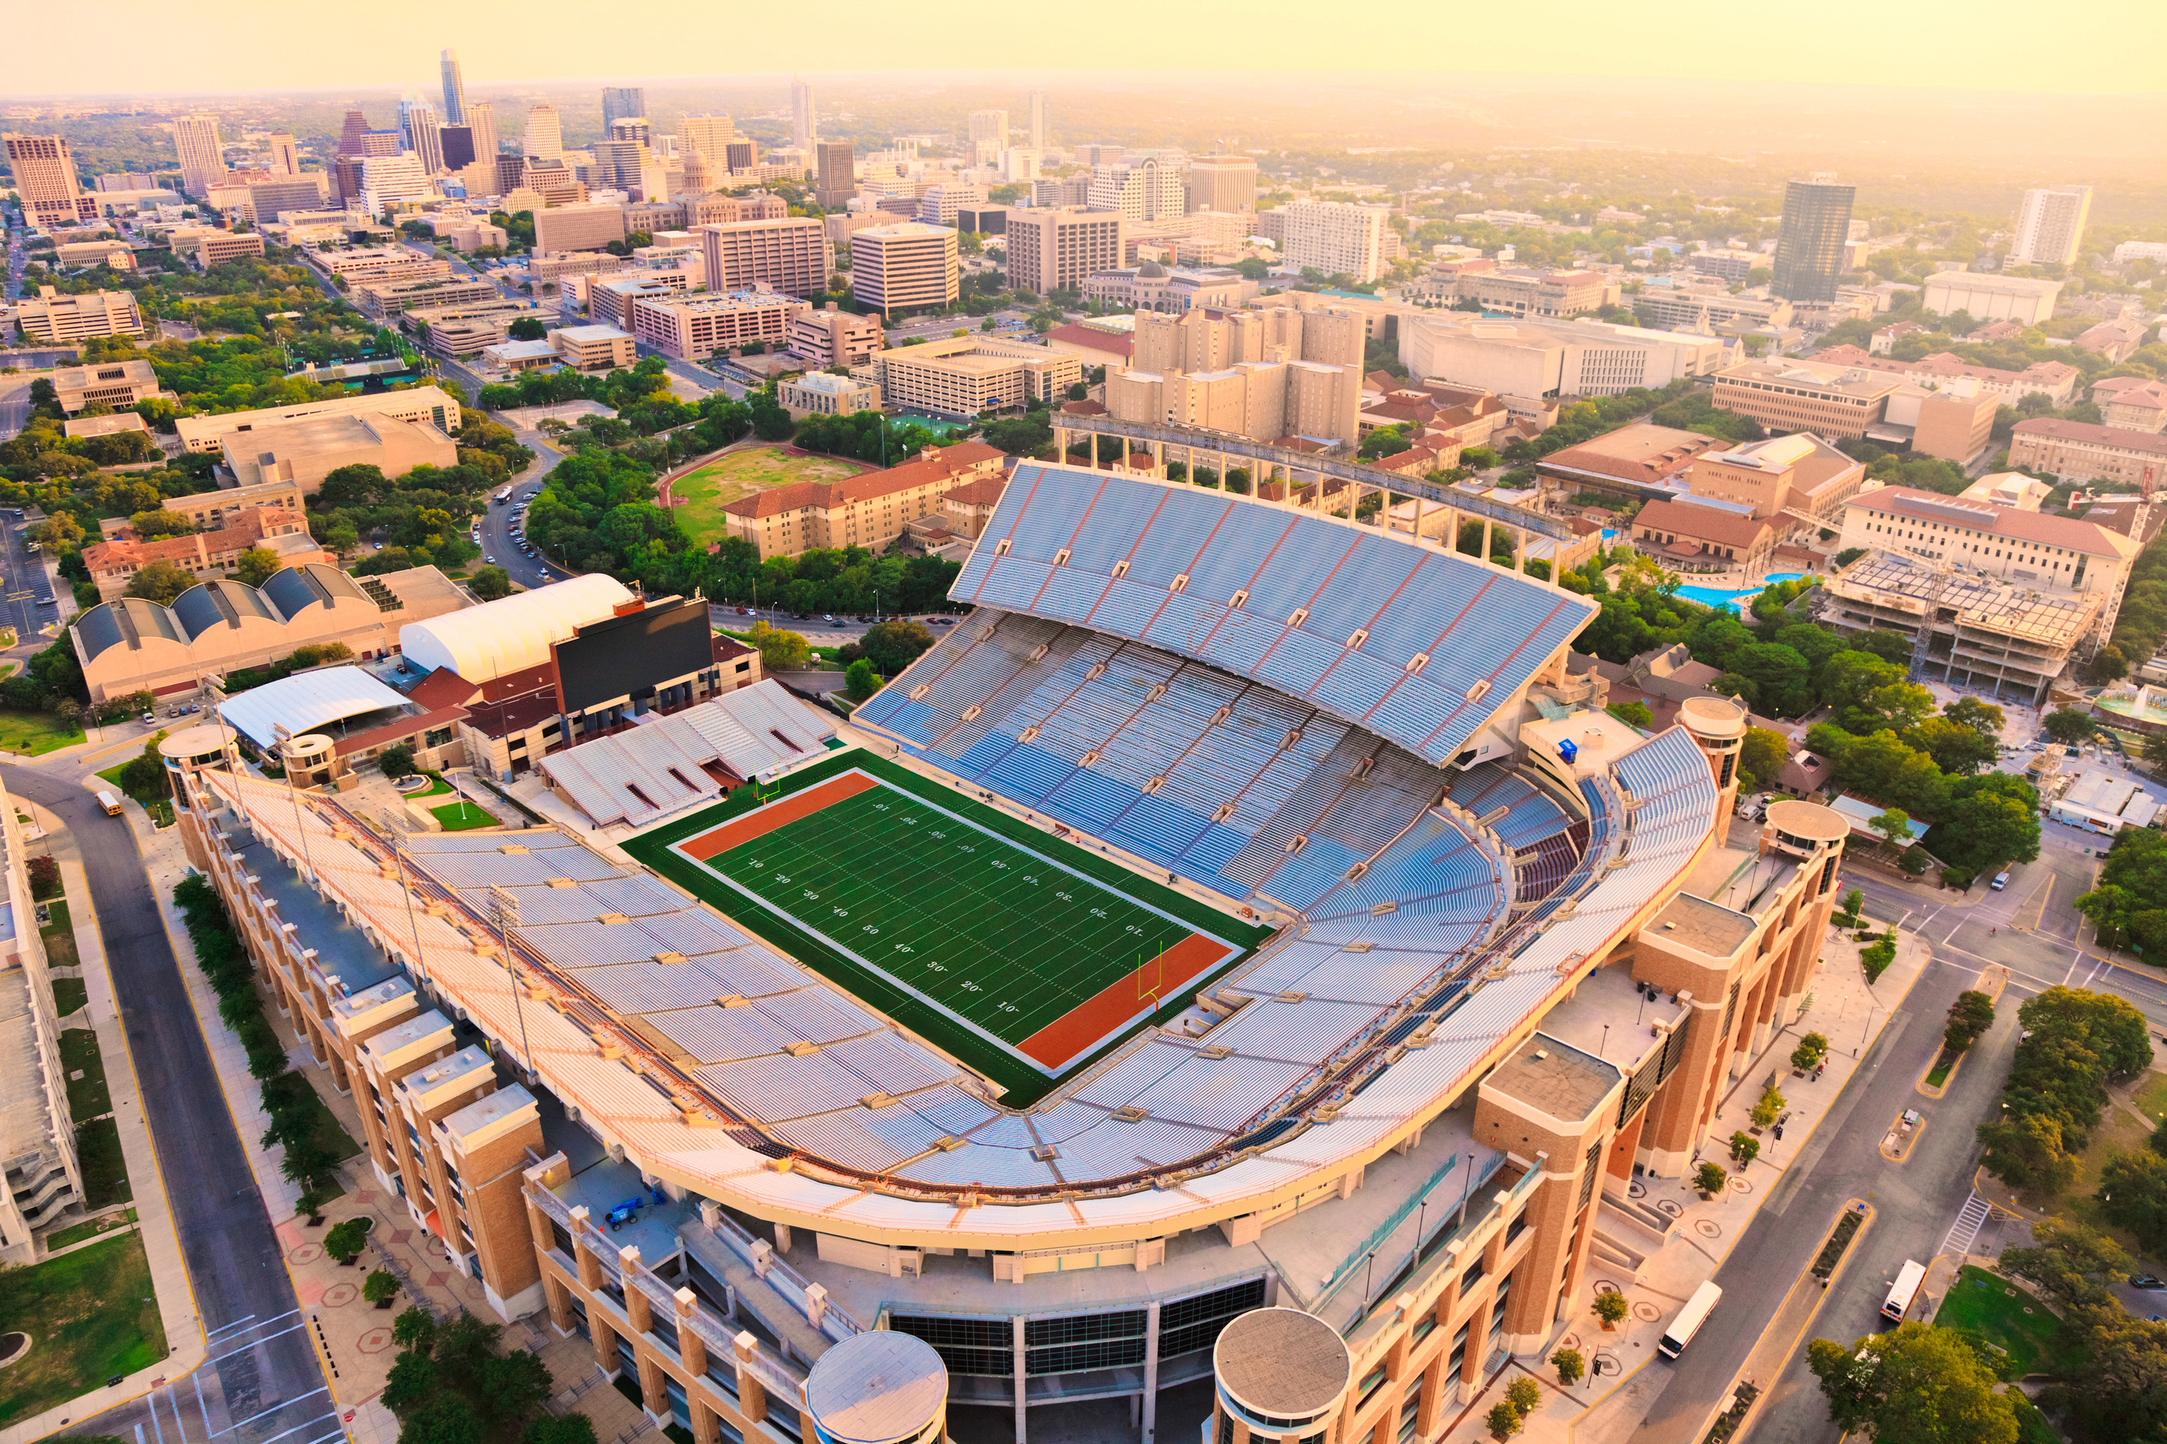
RECOMMENDATION
Developing the weather-attendance algorithm is practical and valuable for Toronto FC, enhancing fan engagement and recognizing loyalty. This data-driven approach will set a new standard in fan appreciation.

Slide 13

THANK YOU
REFERENCES:
https://en.wikipedia.org/wiki/BMO_Field
https://www.statista.com/topics/2892/major-league-soccer-mls
https://soccerstadiumdigest.com/2023-mls-attendance
https://api.open-meteo.com/v1/forecast
Weather Data Services | Visual Crossing

